Slide 1
Financial Aid 101
Notes:
Last review/update: 9/21/2026

Slide 2
Discussion Topics
What Is Financial Aid?
College Costs and Planning Tools
Financial Aid Eligibility
Types of Financial Aid
Applying for Financial Aid
Next Steps
Tips for Students and Families
Important note: Because of the nature of federal, state, and institutional guidelines affecting financial aid programs, the information contained in this presentation is subject to change.

Slide 3

What Is Financial Aid?
Financial aid is money used to pay for school.

Slide 4

Financial Aid Is Not:
Credit cards
Shopping
Buying a car
Partying
Spring break/vacation

Slide 5
College Costs
DIRECT COSTS
INDIRECT COSTS
Paid directly to the university (billed each term) and includes:
Tuition and mandatory fees
Housing and food
Paid to others and can include:
Books, course materials, supplies & equipment
Miscellaneous personal expenses
Transportation

Slide 6
A Note About Tuition
Tuition rates are approved each June by the U-M Board of Regents and estimated budgets are updated at that time. Current tuition information is available through the Office of the Registrar.
Tuition and fees may be higher or lower depending on a student's program of study;
OFA’s published estimated budgets use information from the College of Literature, Science and the Arts.
U-M grant funds are based on financial need and not tied to tuition unless the scholarship is specifically for tuition costs.

Slide 7
College Costs:
U-M Cost of Attendance
 | In-State | Out-of-State
Tuition & Fees | $ 18,896 | $ 67,096
Housing & Food‡ | $ 17,220 | $ 17,220
Books, Course Materials, Supplies & Equipment | $ 1,220 | $ 1,220
Transportation | $400 | $400
Misc. Personal | $ 2,458 | $ 2,458
TOTAL | * $ 40,194 | * $ 88,394
* This is the maximum amount of financial aid you can receive.
‡ Based on average dorm rates and the unlimited basic residential meal plan.

Slide 8



College Costs & Planning Tools
U-M cost planning
Net price calculator, aid comparisons, and more
College Scorecard
Compares colleges
from around the country

Slide 9


More Planning Tools
U-M Net Price Calculator
A free, interactive tool that provides estimated net cost
Uses institutional data
Calculates individual situations
Federal Student Aid Estimator
Free federal tool
Early estimate for federal student aid
Offers options to pay for college

Slide 10
Financial Aid Eligibility
Student Aid Index
Calculated using a federal formula with information from the FAFSA
Eligibility indicator for financial aid
The same at every institution

Slide 11

Calculating Financial Need
Cost of Attendance (COA) example | $38,548
Student Aid Index (SAI) example | minus $5,000
Calculated Need | $33,548

Slide 12
Types of Financial Aid
Grants, some scholarships, Work-Study, and a subsidized federal loan are need-based.
Free Money
Earned Money
An unsubsidized loan is not need-based, and students can receive one as long as the FAFSA has been completed and full costs aren’t already met.
Borrowed Money
Notes:
Grants, some scholarships, work-study and a subsidized federal loan are need based. An un-subsidized loan is not need based and student can receive one as long as there is a financial need and the FAFSA has been completed.

Slide 13
Free Money (or, Gift Aid)
Scholarships
  Earned in some way: grades, skills, service, etc.
  Awarded by a variety of organizations
  May, or may not, require FAFSA and/or other applications
Grants
  Need-based
  Must complete FAFSA to apply
  May need to complete other applications such as
  CSS Profile or other institutional forms

Slide 14
Explore Scholarships
Use free scholarship search engines
  Examples: College Board’s Scholarship Search, Appily, Fastweb!, CollegeScholarships.com, Scholarship America
Search based on your interests, career goals, and affinities
Maximize local and state resources
  Examples: U-M Alumni Clubs, State of Michigan scholarship programs, local Promise and regional scholarships, Community Foundation awards

Slide 15

Watch For Scholarship Scams
Be skeptical about:
Scholarships with application fee
No contact telephone number
Unsolicited scholarship opportunity
Hype or pressure to participate
Scholarship services that guarantee success
Social Security number, checking/savings account info requested

Slide 16

Understand Your Scholarship
One-time vs. renewable
  If renewable, are there requirements?
  GPA
  Specific major/degree program
  Full-time
Tuition-specific scholarship
What’s the value of the scholarship?
  Full ride vs. partial (Will you have remaining costs?)

Slide 17

Go Blue Guarantee
Free U-M​ tuition​ for ​four years
General eligibility:
  Must qualify for in-state tuition​ and be earning first bachelor's degree
  Family income of ​​$125,000​ or less; assets below $125,000
  Must apply and be eligible for ​financial ​aid
More information: goblueguarantee.umich.edu/ann-arbor

Slide 18

Earned Money (or, Work-Study)
Get paid for your work
Receive paychecks
Have flexible work schedules
Consider on-or off-campus opportunities
Students not awarded Work-Study with their financial aid notice may apply for other jobs on and off campus

Slide 19

Borrowed Money (or, Loans)
Borrow only what is REALLY needed
Repayment begins after graduation
Federal Loans from the FAFSA
Federal Subsidized Direct Loans
Student is borrower, interest does not accrue until repayment
Federal Unsubsidized Direct Loans
Student is borrower, interest accrues day one

Slide 20

Applying for Financial Aid
Notes:
2024-25 Financial Aid 101 no GBG_07.24.2024

Slide 21


Completing Your Aid Applications: Where
Free Application for Federal Student Aid (FAFSA)
Free application
State, federal, and private financial aid resources
Two Aid Applications
CSS Profile
$25 application fee
Need-based U-M grants and scholarships

Slide 22
Completing Your Aid Applications: When
2026-27 CSS Profile
2026-27 FAFSA
2026-27 FAFSA
2027-28 CSS Profile
2027-28 FAFSA
2027-28 CSS Profile
2027-28 FAFSA
2027-28 CSS Profile
2027-28 FAFSA
Due: Nov. 15
2026-27 FAFSA:
Spring: May 10
Summer: June 1
2027-28 apps: Mar. 1
Due: Nov. 15
Suggested: Dec. 15
Due: March 1
Winter Start
Spring/Summer
Early Decision
Early Action & Regular Decision

Slide 23
Completing Your Aid Applications: How
Important documents and steps
Federal Student Aid Account (FSA ID & Password) All Contributors*
2025 Tax Return
  FAFSA will automatically transfer data from the IRS
  CSS Profile will require you to report the information yourself
Bank/asset statements
Child support (paid or received)
Other untaxed income

Slide 24
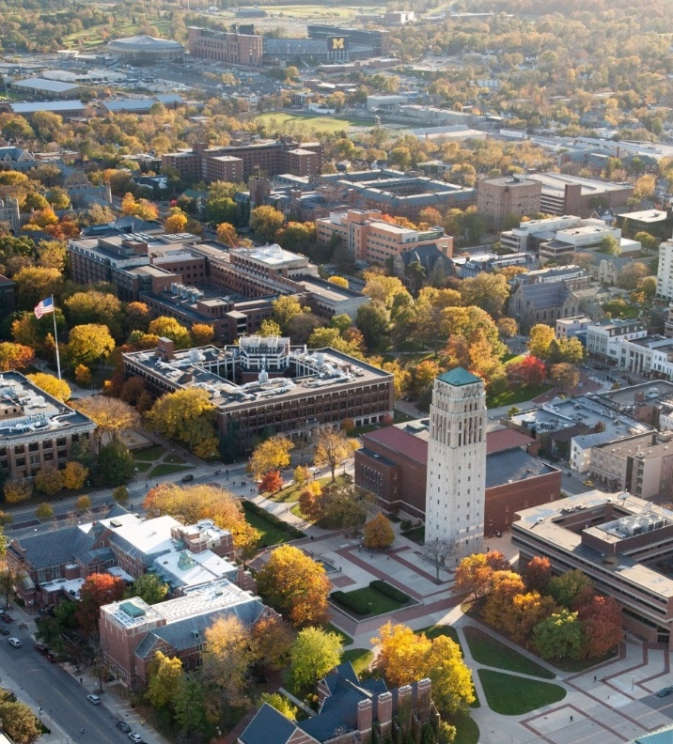
Completing Your Aid Applications: Why
Why should you complete the FAFSA and CSS Profile?
Gain access to multiple sources of aid
List multiple schools on your applications
Report information early in case you ever need to appeal due to special circumstances

Slide 25
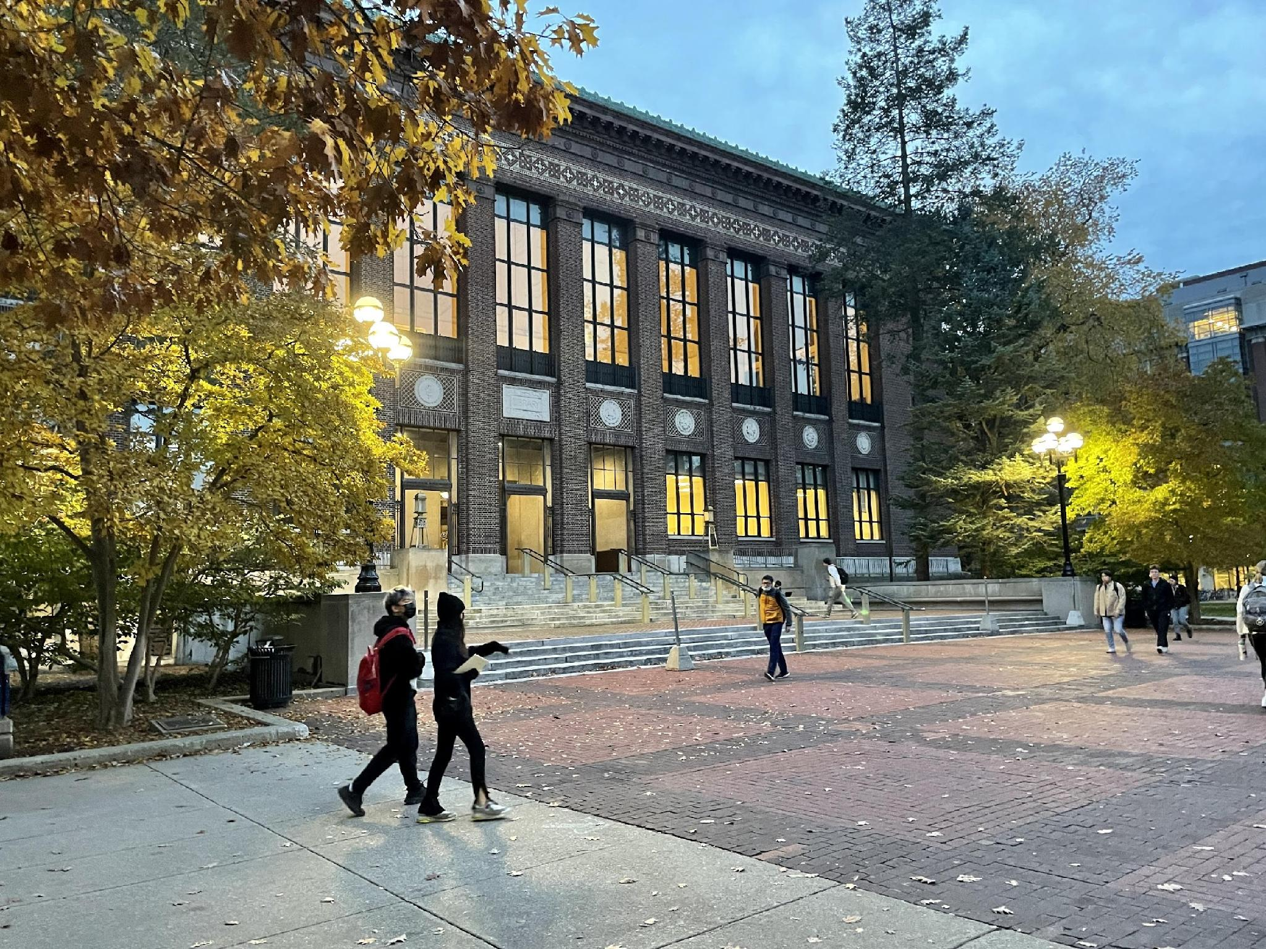
Completing Your Aid Applications: What
What should I expect?
Information sections are broken up so that student information is reported separately from parent information.
“As of today” language

Slide 26
Completing Your Aid Applications: Who
Each Student (Parent data can be transferred for multiple children)
FAFSA Parent Contributor(s)
  Both parents (biological, step-parent, adoptive) if married
  Only one parent if single, divorced, or separated. The FAFSA form requires information from the parent(s) who provided the most financial support or, if that’s equal, the parent with the higher income and assets.
  If both parents live in the same house and are not married, both incomes go on FAFSA

Slide 27
Completing Your Aid Applications: CSS Profile Households A and B
U-M requires information from both biological parents
If parents are divorced/separated, both households must report information on the aid application
CSS Profile HHA (custodial) and HHB (noncustodial)
An appeal process for an HHB waiver is available if one parent cannot be located or contacted, or it is unsafe to do so. See the OFA website for information.

Slide 28
Dependent vs. Independent
Dependent
Requires parental information
Most U-M students dependent
  Does not consider student tax filing status.
  Does not consider parent unwillingness to contribute.
Independent
No parental information reported
Who is independent? (partial list)
  Married
  24 years old or older
  Orphan, foster youth, ward of the court/state, legal guardianship
  Responsible for dependents
  Homeless or at risk of homelessness
  Veteran or active duty

Slide 29
Avoid Frequent Aid App Errors
Incorrect U-M school code (be sure to select the UM-Ann Arbor school code: 002325 on the FAFSA and 1839 on the CSS Profile)
Social Security numbers
Divorced/remarried parental information
Student/parent income
Real estate & investment net worth
Work-Study preferences

Slide 30
Your Aid: Next Steps
Confirm all aid application information is correct and make necessary corrections
Complete institutional forms
  CSS Profile (if not already completed)
  Scholarship applications
  Additional documentation, if requested by the aid office (federal tax transcripts, W-2s)
Aid offers will be sent within a few weeks of admission if you submitted aid applications by their deadline
  Official vs. Estimate Offer: Estimated notices are based on initial calculated need and not binding

Slide 31
Your Aid: Special Circumstances
Send explanation to each financial aid office
  Ex: change in employment, death, marital status, one-time significant benefit, large out-of-pocket medical expenses, etc.
Be prepared to provide supporting documentation of circumstances.
All special circumstances will be reviewed within three weeks of submission, and a FINAL decision will be made*
Note: If you have an unusual circumstance where parental data cannot be provided on the FAFSA, contact the Office of Financial Aid about your options.
*Appeal decisions are final and cannot be appealed to the U.S. Department of Education.

Slide 32

Tips for Students and Families
Consider payment plans
Know before you Go Blue!
Satisfactory Academic Progress
Apply for scholarships every year
Meet all deadlines
  Check and respond to your email
  Check and respond promptly to requests
Problems/issues
  Talk to the experts on campus

Slide 33
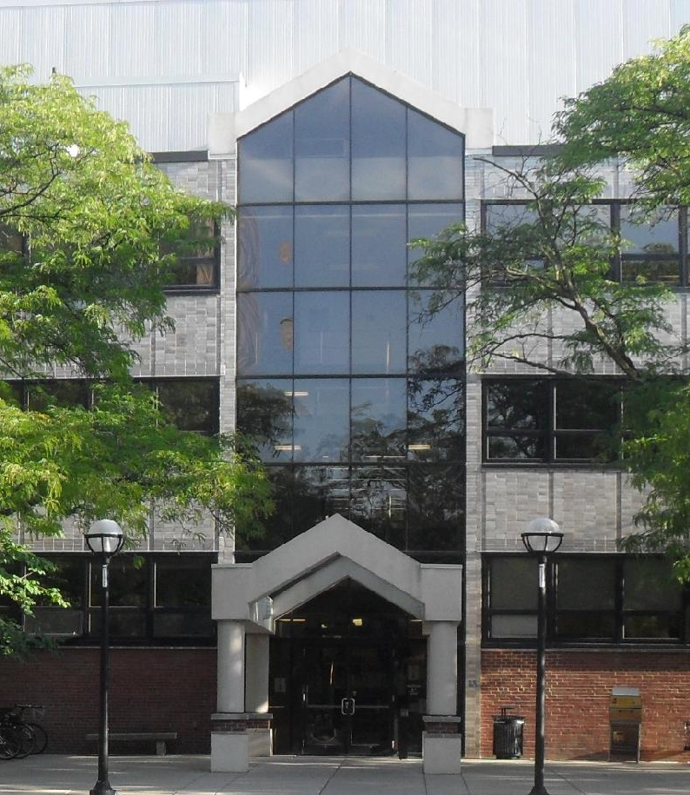

Thank You!
Office of Financial Aid
515 E. Jefferson St.
Ann Arbor, MI 48109-1316
finaid.umich.edu
Outreach Unit
ofa-outreach@umich.edu

