Slide 1


College Application Process
Presented by
Dakota High School Guidance Department

Slide 2


10th – 12th grade counselor
caseload breakdown
Mr Anderson = A – Cie
Mrs. Gay = Cif - Gor
Mrs. Ede = Gos – Lee
Mrs. Coles = Lef - Pat
Ms. Simmons = Pau - Smis
Mrs. Carr = Smit – Z
Counselors can help with career exploration, college planning, academic advising, providing referrals for outside resources, and more.
The Secretaries: Mrs. Kreft and Ms. Packer
Need a document or form? For work permits, transcript/parchment questions, signed letters for court or Social Security benefits, there is no need to sign up to see your counselor. Ask one of the secretaries for assistance.

Slide 3

Topics of Discussion
New parent contact sheet
Financial Aid
Scholarships
College admissions criteria – what they’re looking for
Finding the right fit
College applications and the Common App
Student Athletes
Timeline by month
*Please enter your questions in the chat, and we will do our best to answer them.

Slide 4
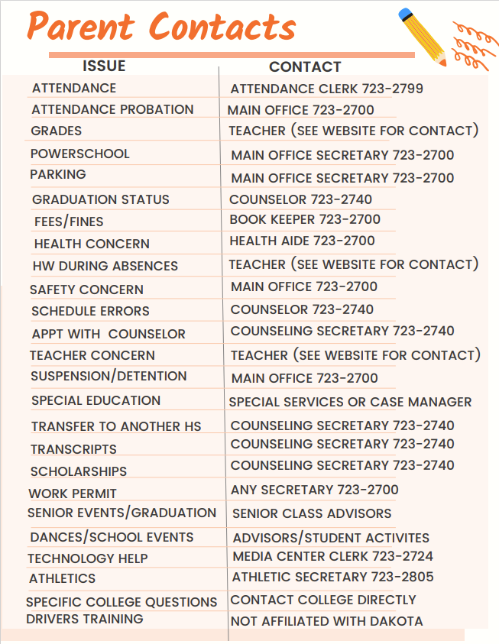

Slide 5

Financial Aid
The “true cost” of college includes tuition, room/board, books, other fees, spending, miscellaneous. Do not forget to account for those “extras”.
FAFSA (Free application for Federal Student Aid) has changed – they are still working out the kinks. You can always check for updates: https://studentaid.gov/h/apply-for-aid/fafsa
Be sure to attend our virtual Financial Aid Night on September 25, 2024 at 6:00 pm.

Slide 6

Scholarships and Financial Aid
Scholarship searches are not a one-time task – it should be an ongoing process.
  Consider setting up a separate email just for scholarships.
Regularly check Dakota’s Website starting in September of senior year.
Listen to announcements - parents can sign up for announcements too.
Never pay for a scholarship search. Reputable sites will be free.
Do not provide your social security number. Credible sources do not ask for/need it.
Reputable sources:
  Fastweb.com
  Scholarships.com
  Collegeboard.org
Xello – students have an account; you can search colleges, careers, scholarships, etc.
Notes:
Reliable sites for scholarship searches:
Fastweb.com
Scholarships.com
Collegeboard.org → scholarship search
Xello → scholarship search
Do not pay for it or give out your social security number to companies offering to help.
On Dakota’s website, under the counseling tab, under Financial Aid & Scholarships, we regularly post opportunities throughout the year as they are sent to us. Make checking this a regular practice.

Slide 7

College Admissions Criteria
Academic Performance/GPA
  Weighted v. unweighted = if you took AP classes and received the bump, your GPA and rank are weighted
  If an unweighted GPA is requested, you will have to calculate it manually
Strength/rigor of Curriculum - and/or a recent upward trend in grades
Solid scores on ACT or SAT - some are test-optional; when to send scores?
Leadership skills
Special talents and accolades
Personal Essays
Letters of recommendation
Fee waivers – for those with documented financial need, such as free/reduced lunch
Notes:
Weighted v. unweighted: If you took AP classes, the GPA we provide is weighted. You will need to calculate it if you need an unweighted GPA. Many universities will un-weigh the GPA, recalculating it prior to making admissions decisions.
Universities want to see rigorous classes, not just good grades.
Many schools are test optional – before sending scores, look at the university’s average score – if yours is at or above, send the score. It it’s below and the school is test-optional, do not send it.
Most universities are going to be test-optional for 2023.
Some universities will ask about students’ leadership experience. Even more important is demonstration of finding a balance of academics and extracurriculars.
Personal Essays – they want to learn more about you as a person –talk about a pivotal moment or an important lesson you’ve learned; start early; can use the same essay for multiple schools/scholarships.
Letters of recommendation – some will require 1, some will ask for 3, and some do not want/need any. Do not request or submit letters if they are not required.
Fee waivers for applications, retaking SAT/ACT. Contact the counselor.

Slide 8

Finding the right fit
Factors to consider:
Academic ability, Emotional maturity, & cost
Academic programs offered – does the institution have a good program in their field of interest? Don’t just focus on “name brand” schools.
Admission criteria – do you meet or come close to their expectations?
True cost
Location – distance from home; Setting - urban, suburban, or rural.
Type – 2 or 4 year; Public or Private; a religious affiliation.
Size – of student body; of campus; student to teacher ratio; class size.
Facilities and Housing – residence hall condition; student resource center; residence; meal plans.
Activities – sports, intramurals, clubs, sororities/fraternities, other?
Anything unique about the campus or program that stands out?
Notes:
It is important to look at what programs a school offers. Many students want to go to certain universities based on name-brand, and that school may not even offer a program in their field of interest.
Name brand universities do not guarantee a good job or a high salary. You can get a great job w/ excellent pay without having to go to a highly-selective university.
The cost of college includes more than just tuition and room/board. Make a plan that includes those other fees.
To find the right university, students should consider what setting they would feel most comfortable in. Some may not feel comfortable living in the city or living in a rural area that is too remote. That can impact a student’s happiness at their university.
Review admission criteria in advance so the students can make sure they will qualify or to identify what they may need to do to make themselves a better candidate.
What other characteristics about the university make it stand out above others? Use a checklist of traits you want in a university. Use a point system to rank each one you’re considering. How well does each university meet each criteria?

Slide 9


The College Application
College Applications can be found on each college’s website.
The Common Application –
  What is it? How it differs from a regular college application.
  When to use it?
  What to supply the counselor – senior profile
  Do not wait to submit transcripts. You can send them while waiting for counselors to submit the school report.
  Counselors will not have the proper documentation to complete our part until sometime in October. We will get it done by the deadline.
  Early Action v. Early Decision –this is important to understand.
What to do if deferred.
Transcripts need to be requested separately from applications.
Notes:
Common App – a website where students fill out one application for multiple schools. If you are applying to more than one school on the common app, it can save time, but if you are only applying to one and they have their own app or the common app to choose from, you may want to do their app instead of the common app because it is very lengthy.
The counselors will have to submit a portion for each student as well. The student will need to complete and submit a senior profile form, on our website under college/career planning, to assist us in completing our portion.
Counselor reports are typically due November 1st. Students may submit their application in August or September, but counselors typically do not have all of the necessary information to submit our portion until the end of September or beginning of October. Students are not penalized for this. As long as student applications and counselor reports are submitted by the deadline, everything will be fine. Students do not get early consideration for submitting months in advance.
It is important to provide at least one week notice for recommendation requests or anything that will require another person to complete something. Waiting until the deadline/last minute may mean students do not get what they need.
Early Action just means you want notification of admission as soon as possible from the university. Early Decision means that if you get admitted to that university, you must go there and withdraw all other applications. It is a binding agreement between the applicant and the university.
If deferred, it is important to start looking at other options. Maybe it’s a blessing in disguise. Also – you can contact the university you were deferred from to re-express interest in attending. Notify counselor as well, so the counselor can reach out on their behalf.

Slide 10

Student Athletes only
National College Athletic Association (NCAA)
Establishes rules on eligibility for college athletes.
Three membership divisions: Division I, Division II, Division III. Institutions are members of a specific division according to the size and athletic program.
Visit www.eligibilitycenter.org to see what classes from your high school count and to access the Division course requirement worksheets
$90.00 Fee
Register as early as sophomore year. MUST sign up before start of senior year
National Association of Intercollegiate Athletics (NAIA)
Exists to advance character-driven college sports. It provides high school and transfer student-athletes the opportunity to keep playing sports while receiving an outstanding education. Over 60,000 student-athletes compete at NAIA institutions.
Visit www.playnaia.org to see eligibility rules and register.
$70.00 Fee
Notes:
MUST apply before senior year starts!

Slide 11

Summer before 12th grade:
Complete a graduation audit with historical grades
Apply for NCAA
Begin or continue discussions about post-secondary plans
Start creating your college list and apply to those colleges:
  Select 4 or more – Reach, Target, and Safety schools.
  Research admission criteria to make sure you’re on track.
Consider doing volunteer work.
Ask teachers for letters of recommendation early
Start searching scholarships
Notes:
Students can use the historical grades screen and a grad audit to confirm they are on track. These can be found on Dakota’s website. Dakota’s website → Counseling Tab → Graduation Requirements → Grad Audit. Notify their counselor if something seems off.
For athletes, you must apply for NCAA before you begin 12th grade.
Schedule college visits if they haven’t started yet. Do so by contacting admissions offices or going online to the university website.
Meet with college reps during lunches
Retake the SAT/ACT, if desired. If you want to retake it, you will need to go directly to ACT.org or Collegeboard.org
Apply to colleges - create a planning calendar to help remember deadlines.
It is acceptable to apply as “undecided” if they’re not sure yet.
Select 4 or more – Reach, Target, and Safety schools.
Make sure the schools offer the program of interest.
They should research admission criteria to make sure they meet it.
Apply in August – less stressful school year if you get started early. Counselors will not have transcripts ready until the end of September/beginning of October. We will meet Nov. 1st deadlines.
They should get involved in extracurricular activities & volunteer work. Demonstrate leadership qualities. Colleges might ask for examples.
Teacher Letters of Recommendation:
Only ask for them if institutions require them.
Give plenty of notice (at least 2 weeks) to the person they are requesting it from.
They will have to provide institution w/ recommender’s contact info and provide recommender w/ the correct admissions email addresses where it needs to be sent.

Slide 12

Senior year Timeline – 1st semester
IMPORTANT: Pay attention to deadlines! Scholarship, college, and financial aid deadlines are firm. * Have the students complete these steps to help them take ownership of the process and feel more responsible for the choices that need to be made.
September – October:
  To submit test scores, request them directly from College board or ACT.
  Begin researching scholarships.
  Check DHS website and announcements for scholarship info and colleges coming to visit.
  Set up college visits/tours to help you start narrowing down your choices –
    You can do this by going to college websites and/or by contacting their admissions offices.
    It may be helpful to keep a comparison worksheet to help narrow the choices later
  Transcript requests: create a Parchment account. Directions are on Dakota’s website under the counseling tab.
  Attend Financial Aid Night for more information/assistance – 9/25/24 at 6:00 pm

Slide 13

Senior year Timeline – 1st semester
November –
  Start narrowing choices - use your comparison checklist to keep track of which colleges have what.
  The Common Application and Early Action universities – deadlines as early as Nov 1^{st.}
  Do not wait until the due date to do your part or we will not be able to process our part on time.
December/January
  Check with college before making schedule change requests. It can impact admissions decisions.
  Finish college applications.
  Begin FAFSA application.

Slide 14

Senior Year Timeline – 2nd Semester
February and March – Maintain good grades through June!
April – Make the final decision about which college to attend – weigh the offers, don’t fixate on “name brands”.
May – Deadline to say “Yes” to a college is usually May 1st; Send in deposit, if applicable. Students must also notify the colleges they won’t be attending.
June – In Parchment, they will have to request a final transcript be sent to the college of choice for the Fall – select “hold for grades”.

Slide 15

Questions?
Notes:
What questions do you have that we did not address?

